Slide 1
Payment and billing for e-health care

Slide 2
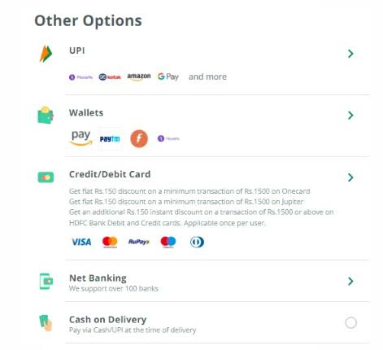
Pharm Easy payments methods

Slide 3
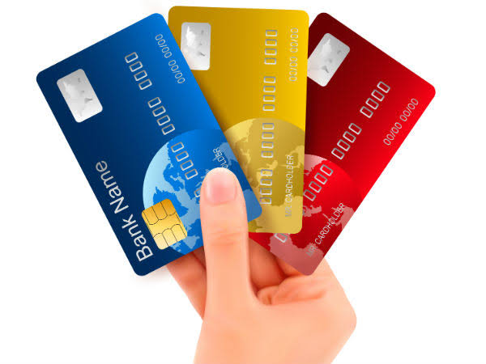
Credit and deBit card payments
As a global payment solution, by enabling payment acceptance via cards merchants can reach out to an international market.
Credit cards are simple to use and secure. The customer just has to enter the card number, expiry date, and CVV, which has been introduced as a precautionary measure. The CVV helps detect fraud by comparing customer details and the CVV number.
Debit cards are considered the best payment method for e-commerce transactions.
Debit cards are usually preferred by customers who shop online within their financial limits. The main difference between credit and debit card is with a debit card one can only pay with the money that is already in the bank account, whereas in the case of a credit card, the spent amount is billed, and payments are made at the end of the billing period.

Slide 4
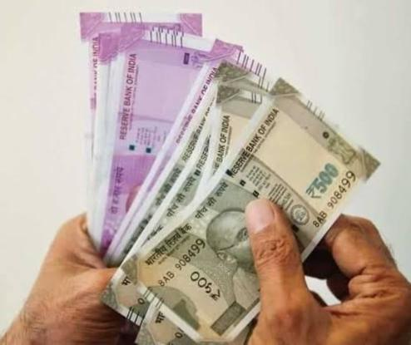
Cash
Let’s face it, in India cash is the king. For eCommerce, it comes in the form of the cash-on-delivery option.
Cash is often used for physical goods and cash-on-delivery transactions. It does come with several risks, such as no guarantee of an actual sale during delivery, and theft. Though nowadays, cash on delivery does not necessarily mean customers pay with cash (they can use cards, mobile payments as payment terminals are often available with delivery agents), missing out on this is a strict NO.

Slide 5
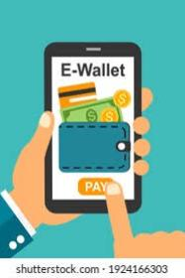
E wallet
E-wallet is one of the upcoming trends which gives a new shopping experience altogether. The use of e-wallets is becoming popular at an alarming rate.
E-Wallets require a sign up from merchants as well as customers. After creating an e-wallet account and linking it to the bank account they can withdraw or deposit funds.
The whole procedure with an e-wallet is easy and fast. Considered as an advanced and instant digital payment method, e-wallets can be integrated with mobile wallets using advanced functionalities like NFC.
Prepaid e-wallet accounts store customer information and multiple credit/ debit cards and bank accounts. It needs one-time registration and eliminates the need for re-entering information every time while making payments.

Slide 6
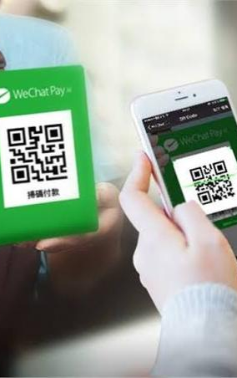
Mobile payments
Payment acceptance was no exception for mobile penetration.
This digital payment solution offers a quick solution for customers. To set up a mobile payment method, the customer just has to download software and link it to the credit card.
As eCommerce is becoming mobile mainstreamed, customers are finding it more convenient to use mobile payment options.

Slide 7
Conclusion
I have navigate these web application and find out the positive / pass and negative / fail test cases. This is to improve the application performance in better manner.

Slide 8
Thank you

